Slide 1
3(a)
explain how a better-trained and educated labour force might affect economic growth. [10]

Slide 2
Definitions/concepts
Labor: One of the four factors of production that refers to the physical and mental contribution of workers to the production process
Economic growth: refers to increases in real GDP over time

Slide 3
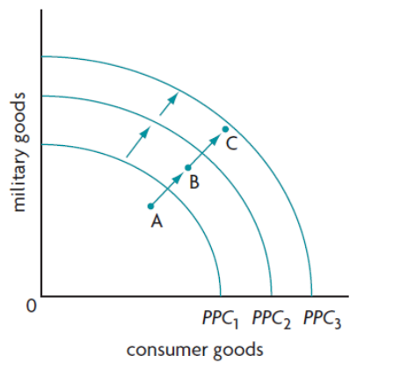
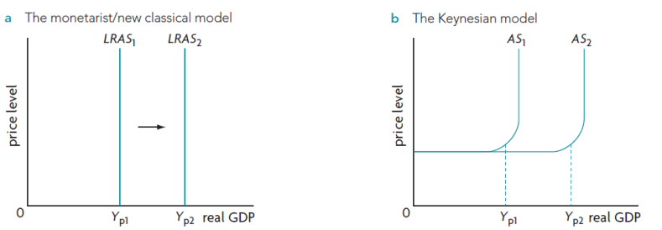
Economic growth diagram
PPC: shift outwards (long term growth)
Monetarist model: LRAS shifts rightwards
Keynesian model: AS shifts rightwards

Slide 4
Evaluation
Better trained and educated labor force
-> improvement in the quality of labor resources
-> more highly skilled and educated workers or healthier workers can provide more output than the same number of unskilled or less healthy workers
-> real output / aggregate supply increase

